Slide 1
UNIT III

Slide 2
Meaning of Project
A project is a scheme, design, a proposal of something intended or devised to be achieved.
A project is defined as a specific, finite activity that produces an observable and measurable result under certain preset requirements.

Slide 3
Definition of project
According to Encyclopedia of Management, “A project is an attainment of a goal – the successful completion of a development project on time within budget, in conformance with pre-determined programme specifications”.
Newman define that “A project typically has a distinct mission that is designed to achieve and a clear termination point, the achievement of the mission”.

Slide 4
Project management

Slide 5
Characteristics of project

Slide 6
Attributes of project
A course of action
Specific objectives
Definite time perspective

Slide 7
Classification of projects - 1
Quantifiable projects
Projects for which quantitative assessment of benefits can be made
Non-quantifiable projects
Quantitative assessment of benefits cannot be made

Slide 8
Classification of projects - 2
Sectoral projects
Agriculture and allied sector
Irrigation and power sector
Industry and mining sector
Transport and communication sector
Social services sector
Miscellaneous sector

Slide 9
Classification of projects - 3
Techno – economic projects
Factor intensity – oriented classification
Capital intensive or Labour intensive projects
Causation – oriented classification
Demand based / raw-material based / skill / other inputs projects
Magnitude - oriented classification
Based on investment – Large / Medium / Small scale projects

Slide 10
Classification of projects - 4
Financial institutions classification
Profit
oriented
New projects
Expansion projects
Service - oriented
Welfare projects
Service projects
Modernization projects
Diversification projects
Research & Development projects
Educational projects

Slide 11
Other Classification
Short term vs Long term – 1 year, more than 1 year
Large, medium, small – size, complexity
Type and area – technical, organizational, economical, social, mixed
Sequential vs Parallel – with order, without order
External vs Internal

Slide 16
Project Life cycle
Conceptual phase
Definition phase
Planning and organizing phase
Implementation phase
Project clean-up/divestment phase

Slide 17
Conceptual phase
The first phase, the conceptual phase, includes the
preliminary evaluation of an idea.
It is a preliminary analysis of risk and the resulting impact on the time, cost, and performance requirements, together with the potential impact on company resources.
The conceptual phase also includes a "first cut" at the feasibility of the effort.

Slide 18
Definition phase
The definition phase is primarily a refinement of those areas considered in the conceptual phase.
The resources required by the project should be defined along with time, cost and performance estimates.
Project estimation is essential where costs are quantified, as this information is needed to establish whether or not the project should proceed.

Slide 19
Planning and organizing phase
The key to a successful project is in planning.
Many people fail to realise the value of a project plan in saving time, money and for avoiding many other problems.
This phase also includes the development of manuals, plans and other documentation that will support the end product in its live environment.

Slide 20
Implementation phase
Preparation of specifications for equipment and machinery, ordering of equipment, lining-up construction contractors, issue of construction drawings, etc takes place at this phase.
80-85% of project work is done in this phase only.

Slide 21
Project clean-up phase / Divestment phase
The divestment phase involves the reallocation of resources that are no longer required by the current project.
The end-product of any project will have a finite lifespan and therefore its ability to generate revenue will be limited.
It is therefore important to retain the services of staff and other resources that can be used in forthcoming projects.
This phase also incorporates the post implementation evaluation of the delivered end-product, and this should serve as input to the conceptual phase of future projects.

Slide 22
Project Manager
A project manager is a person who has the overall responsibility for the successful initiation, planning, design, execution, monitoring, controlling and closure of a project.

Slide 23
Responsibilities of a project manager
Developing the project plans
Managing the project stakeholders
Managing communication
Managing the project team
Managing the project risk
Managing the project schedule
Managing the project budget
Managing the project conflicts
Managing the project delivery

Slide 24
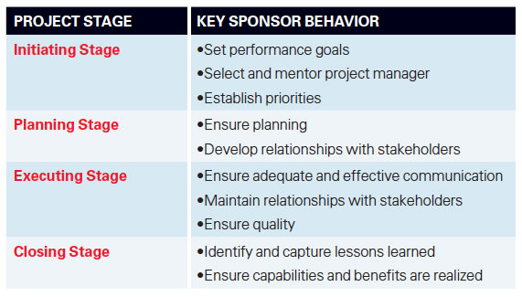
Role of project Manager at each phase of project

Slide 25
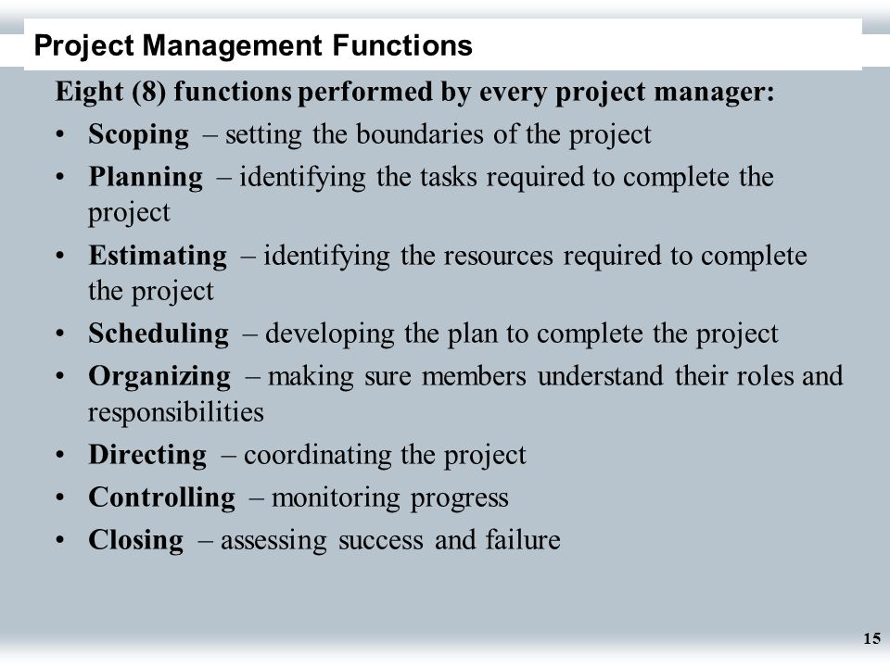
Functions of a project manager

